Slide 1
Title
AgroBot – Universal AI Based Agricultural Assistant
Presented by:-
Arjun Patel

Slide 2
Project Statement
Farmers often struggle to access timely and accurate agricultural information related to crop selection, pest control, weather conditions, and market prices. This lack of information leads to reduced productivity and poor decision-making.
AgroBot addresses this problem by providing an AI-powered platform that delivers instant, reliable, and easy-to-understand agricultural guidance. The system uses Artificial Intelligence and Natural Language Processing (NLP) to assist farmers through a simple and accessible interface.

Slide 3
Project Outcomes
Easy access to agricultural knowledge anytime
Accurate and context-aware responses to farmer queries
Reduced information gap between farmers and experts
Improved decision-making through data-driven insights
Scalable system supporting multiple crops and regions
Increased farming efficiency and productivity

Slide 4
Technology Stack
Frontend:
HTML, CSS, JavaScript
Backend:
Python, Flask Framework
Database:
SQLite
AI
Gemini API
Weather API

Slide 5
Modules Implemented
User Authentication Module
Secure login and registration
Role-based access (Farmer/Admin)
AI Chat Assistant Module
Natural language interaction
Instant agricultural advice
Crop Recommendation Module
Suggests optimal crops based on conditions
Weather Information Module
Provides real-time weather updates
Market Information Module
Displays current crop prices
Pest & Disease Module
Identifies crop diseases and suggests treatments

Slide 6
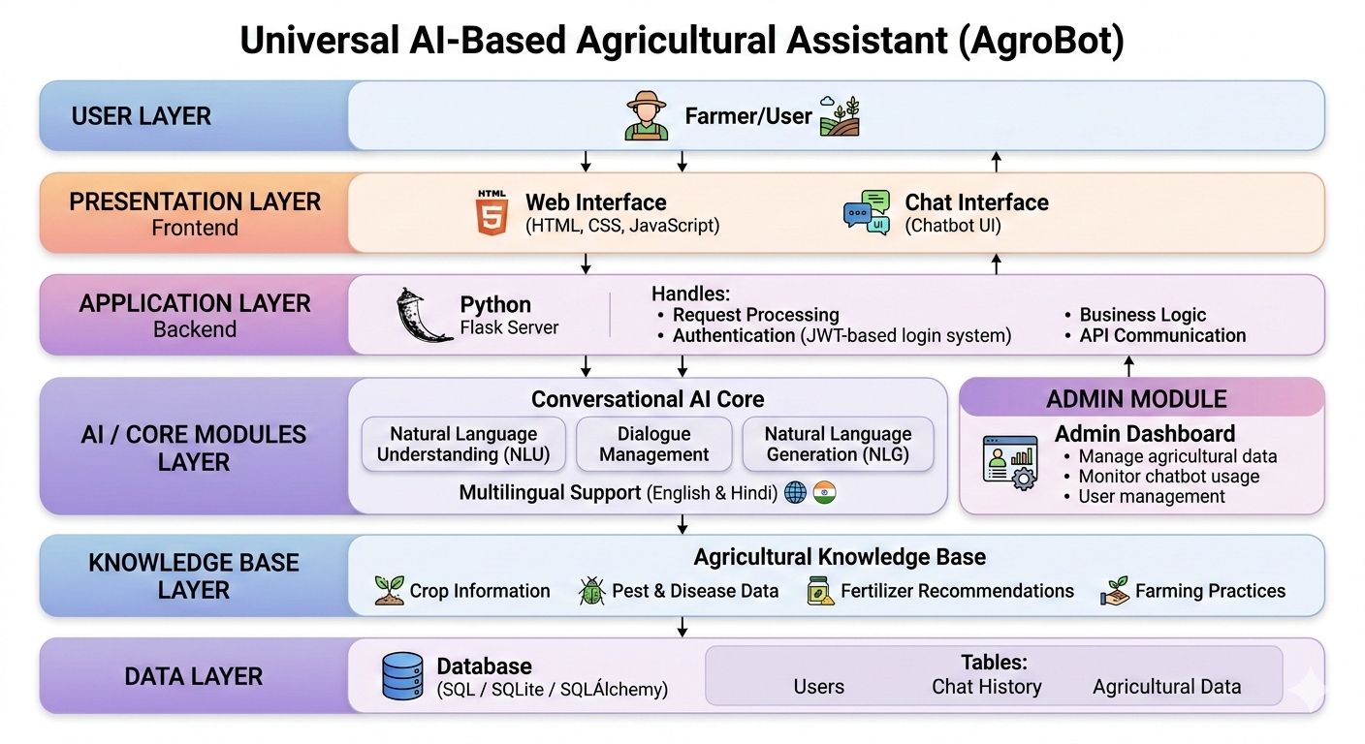
System Architecture

Slide 7
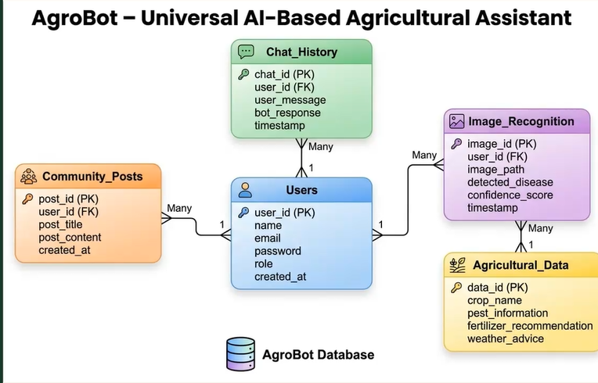
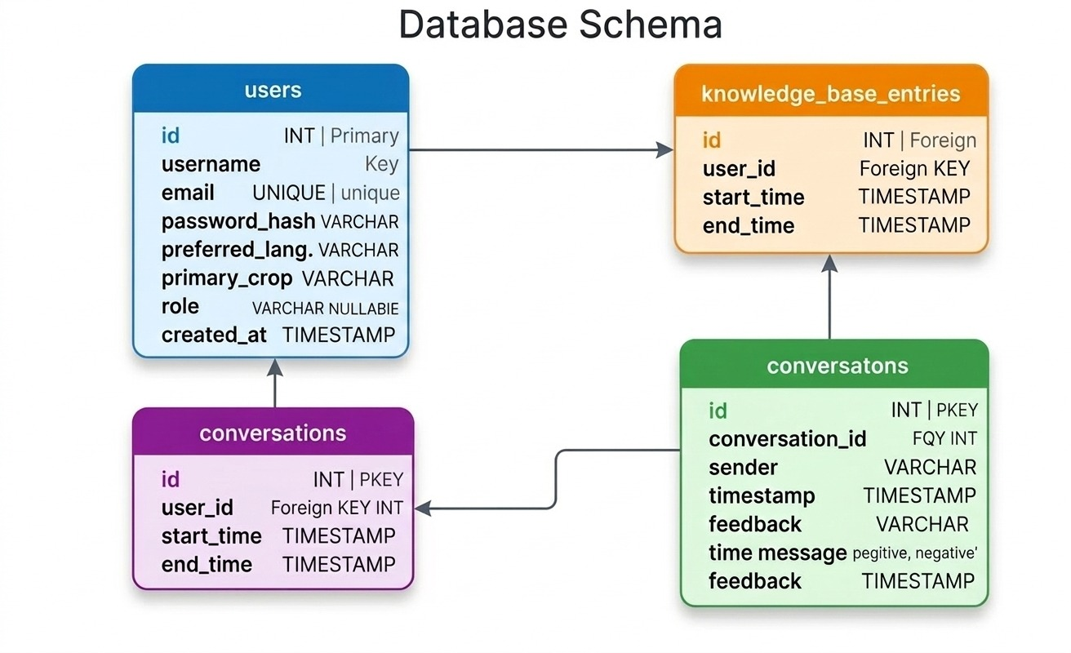
Database Schema

Slide 8
Future Feature Enhancements
Integration with government schemes.
Improve AI API with better version and using different LLMs.
Mobile application version
Connecting IOT Device support

Slide 9
Conclusion
AgroBot is an AI-powered agricultural assistant that simplifies access to farming knowledge. By combining AI, NLP, and real-time data, the system helps farmers make informed decisions regarding crops, diseases, weather, and market conditions.
This project demonstrates how technology can improve agricultural productivity and support sustainable farming practices.

Slide 10
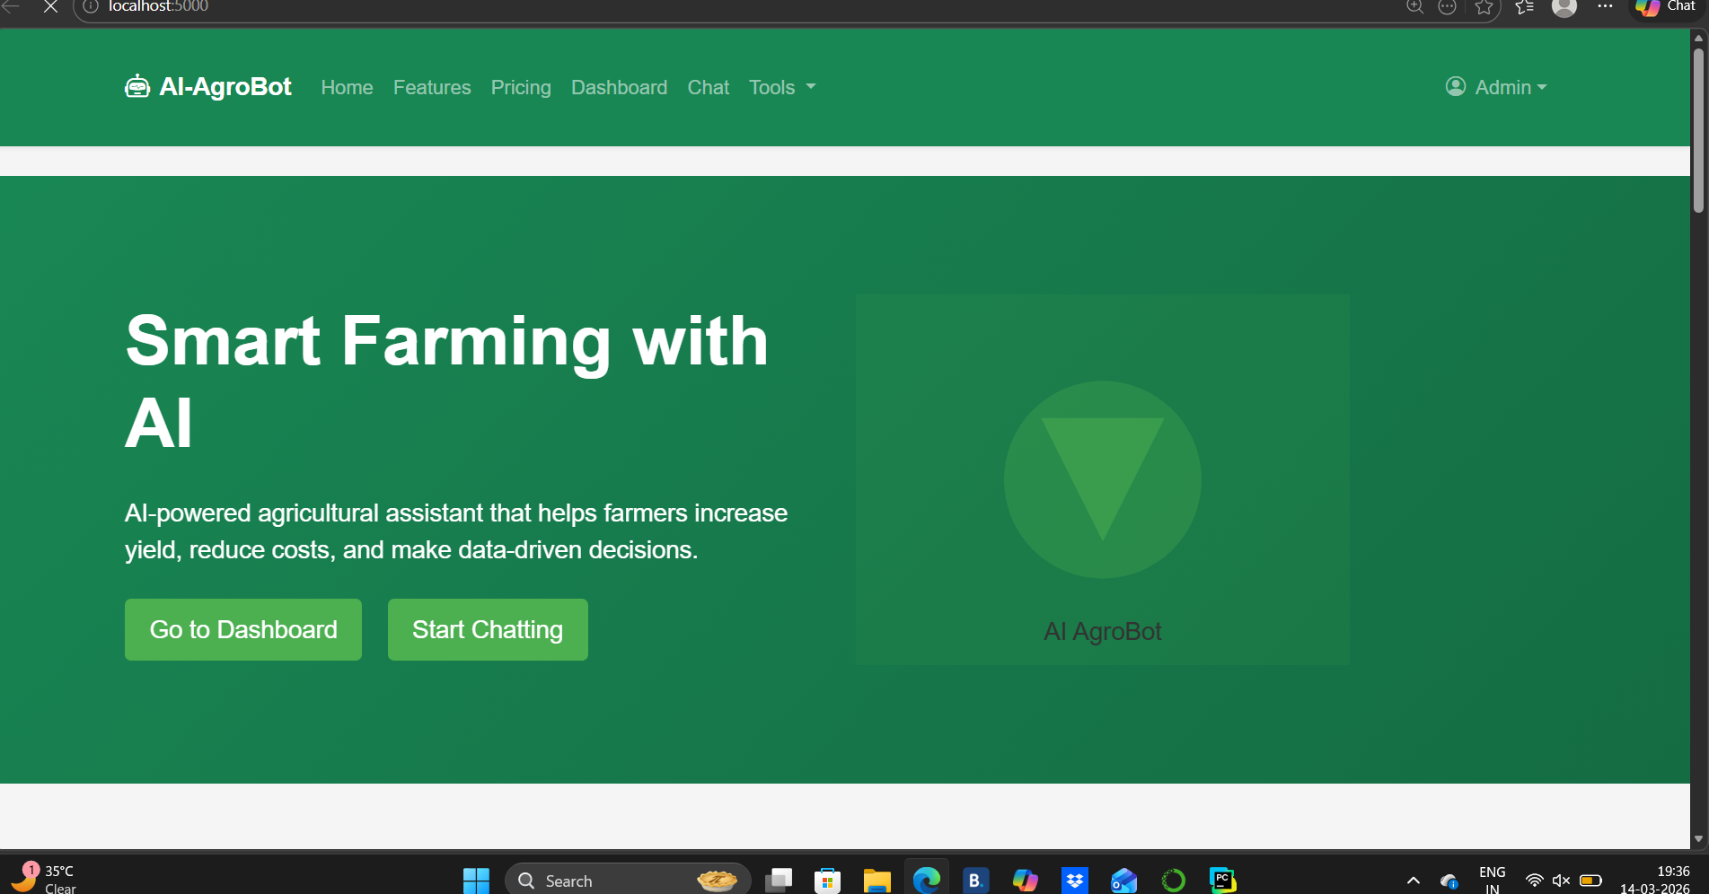

Slide 11
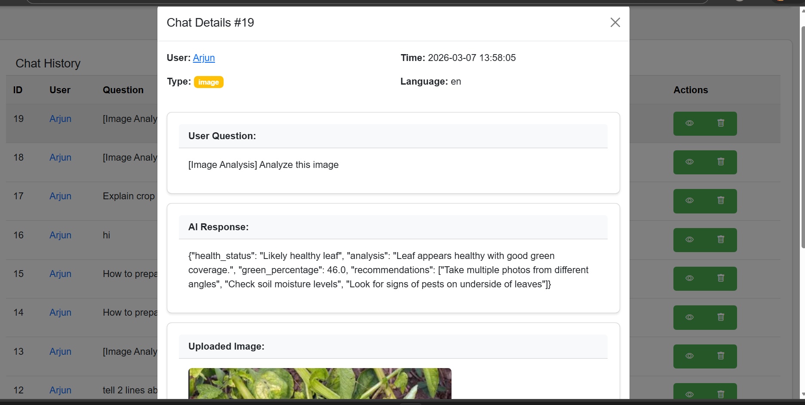

Slide 12
